Slide 1
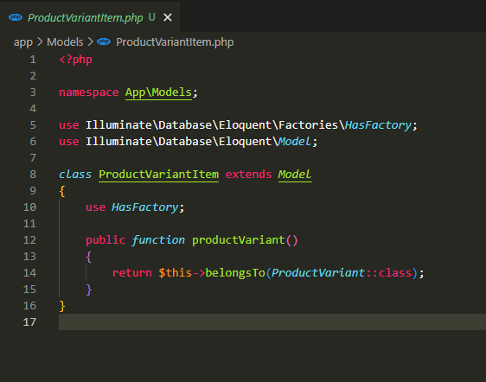
app\Models\ProductVariantItem.php

Slide 2
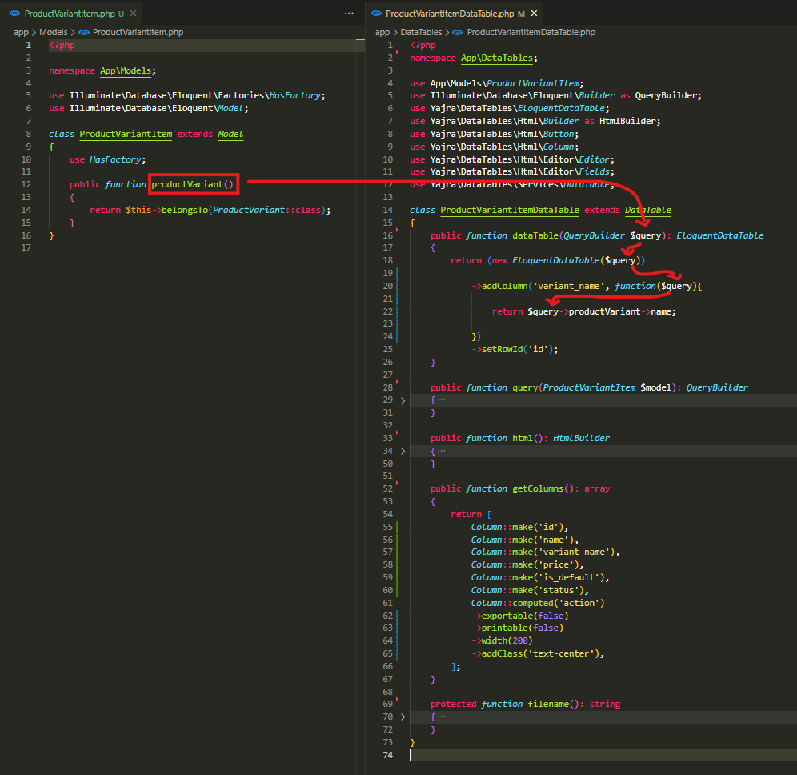

app\DataTables\ProductVariantItemDataTable.php

Slide 3
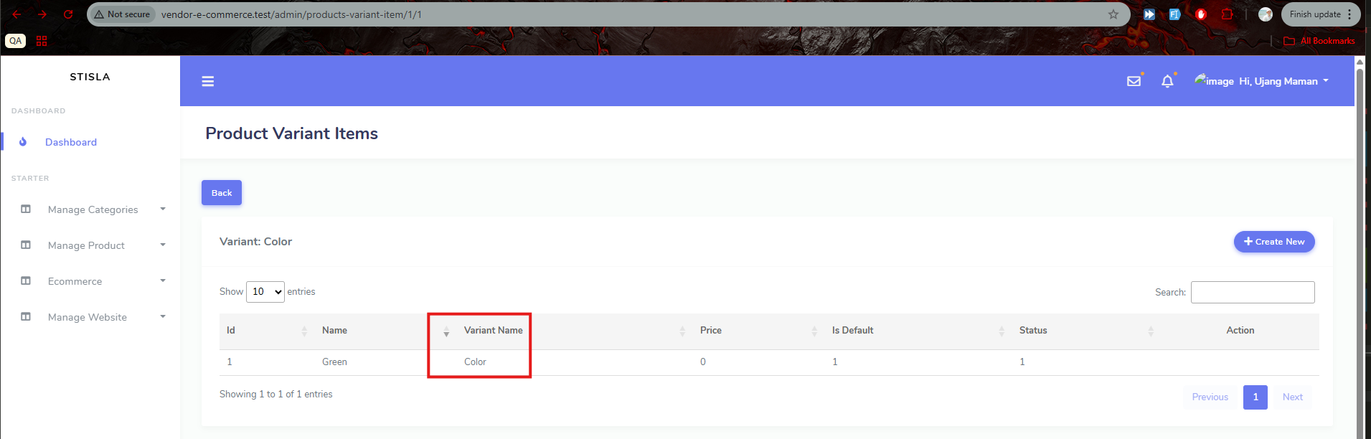
.

Slide 4
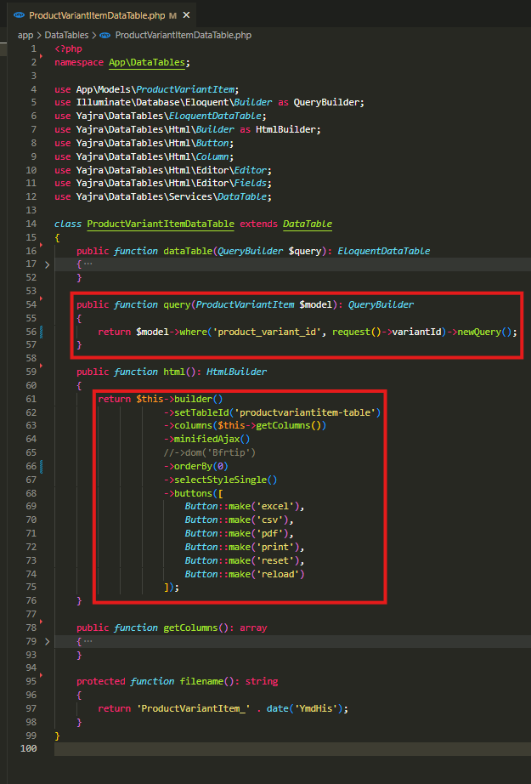
app\DataTables\ProductVariantItemDataTable.php

Slide 5
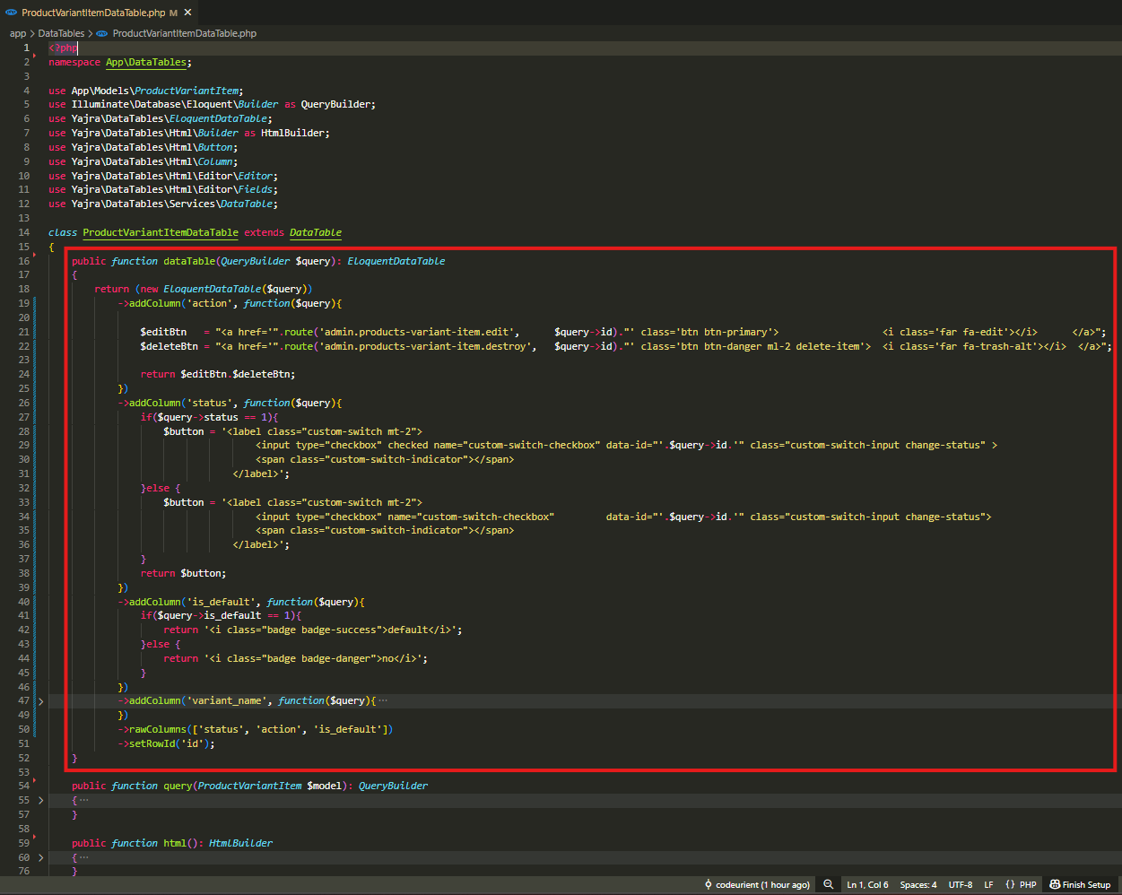
app\DataTables\ProductVariantItemDataTable.php

Slide 6
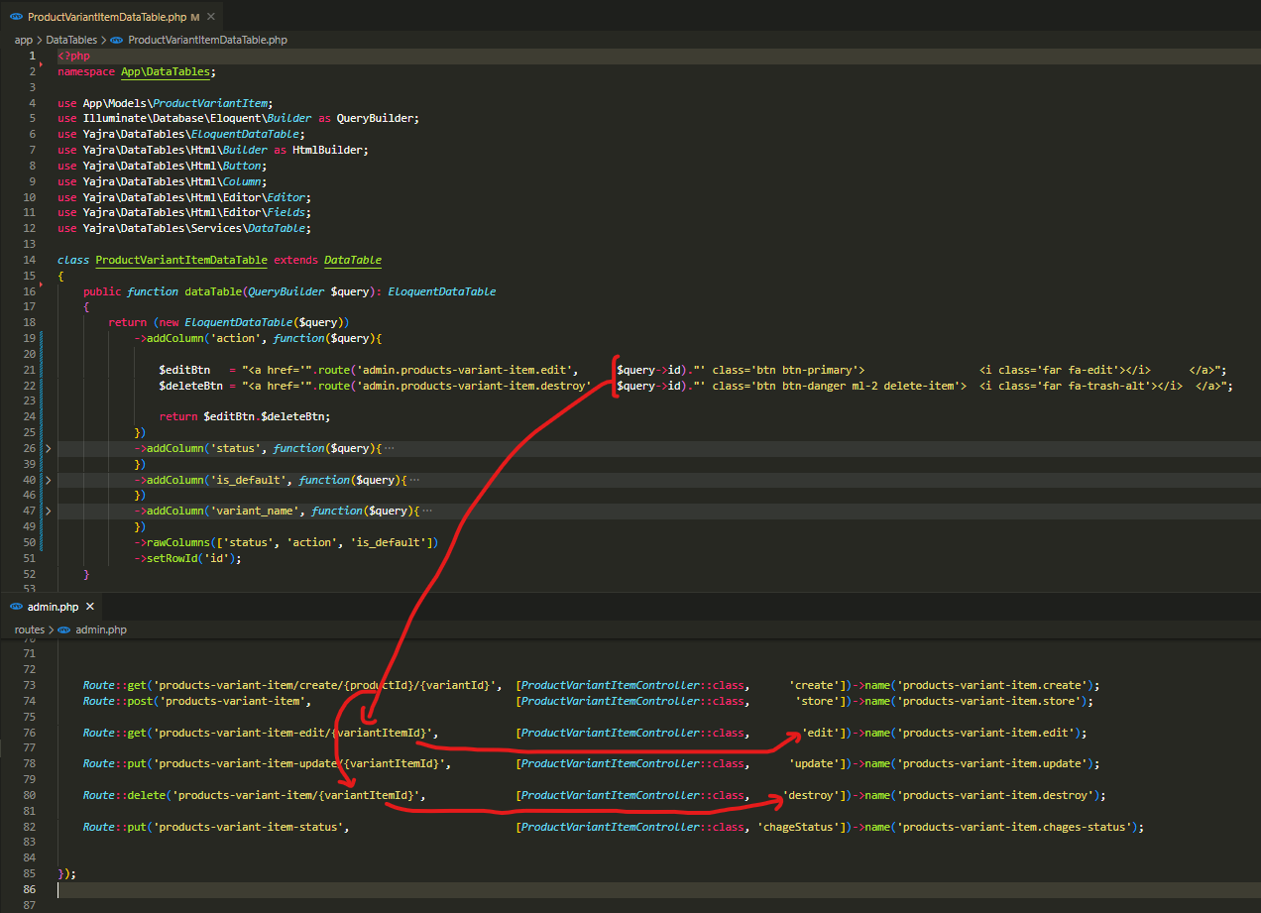
.

Slide 7
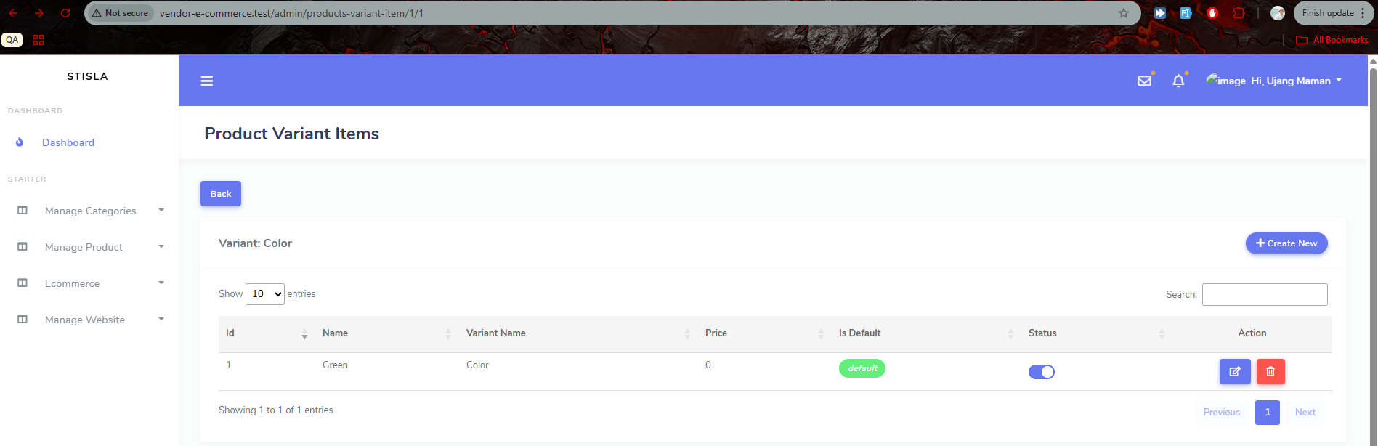
.

Slide 8
.

